Slide 1
AMBIENT AIR FILTRATION IN THE WOODSHOP
By
Lou Gatch

Slide 2
Dust in the woodshop is a serious problem that should be addressed. The air we breathe during our activity in the shop is not totally removed by the most efficient chip collection at the point of machine operation. The most efficient chip collection unit, be it a single stage or 2-stage cyclonic unit, will not remove airborne dust. It actually circulates the ambient air as it exhausts through its filter media.

Slide 3
Airborne dust can easily be seen with the naked eye suspended in the air through a ray of sunlight.
All species of wood dust is known to be a hazard to the respiratory system

Slide 4
To reduce this airborne dust it is advisable to provide ourselves with additional protection as follows:
Wear an approved dust mask rated, NIOSH* N95, at all times when in the workshop. This is not too comfortable but most efficient.
Work on improving chip collection at each point of operation thus reducing the escaping dust/chips.
*National Institute for Occupational Safety and Health (NIOSH)

Slide 5
Use the most efficient air filter material available for your chip collector 5 micron media is now available for many machines.
Shop vacs are not a suitable machine for use as chip collectors due to their small air filters and high noise level
Purchase or make a high efficient ambient air filtration unit sized for your shop.

Slide 6
DETERMINE YOUR NEEDS
Measure your shop to determine the CFM (cubic feet per minute) needed to obtain a minimum of 5-10 air changes per hour.
As an example: Shop size of 15’ x 20’ x 8’h = 2400 cubic feet shop volume x 5 air changes per hour = 12000 cf/hr. ÷ 60 minutes /hour = 200 cfm unit for this shop example would be used

Slide 7
Commercial units are expressed in CFM to choose from. A single unit or multiples may be required to suit the needs. Ideally the air flow from the filter unit should be in a circular pattern around the periphery of the shop. Mount the cleaner centrally located on the long wall of the shop towards the ceiling is a good starting point.

Slide 8
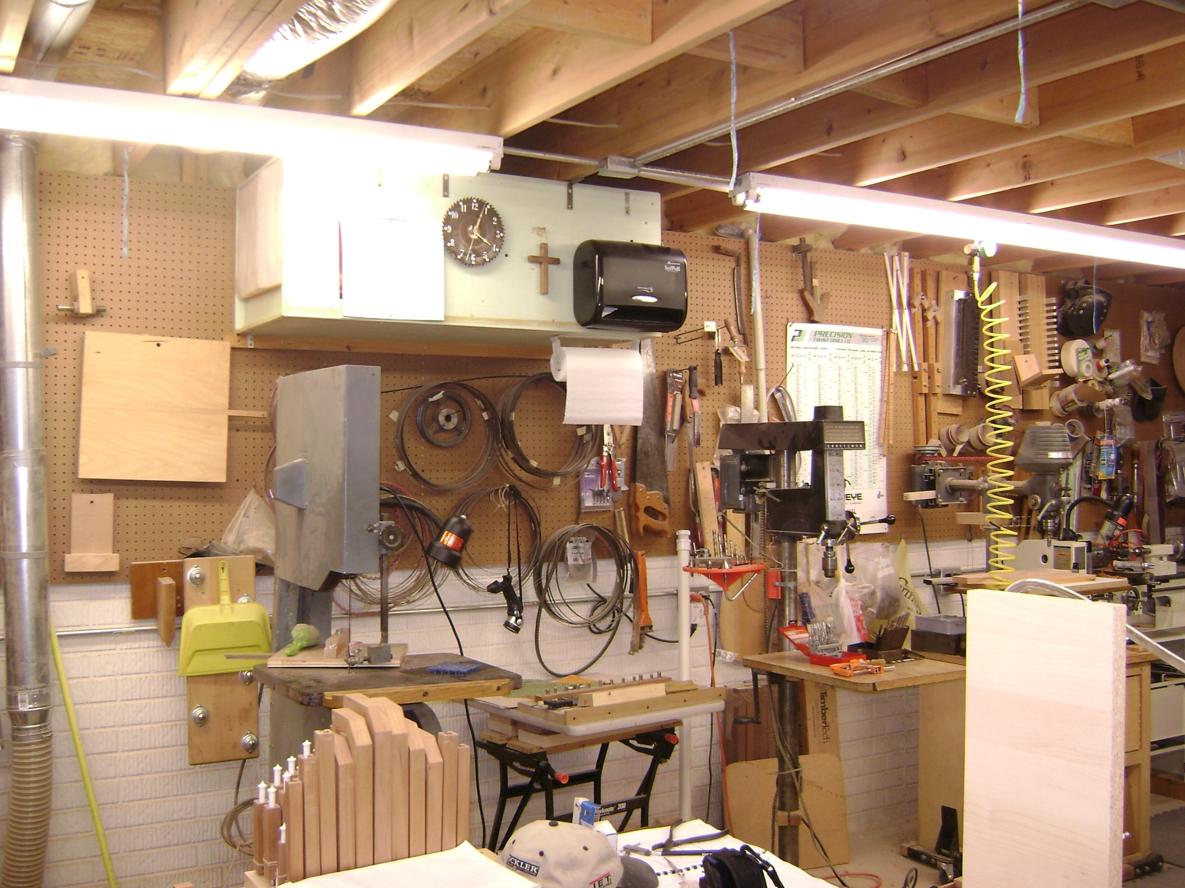

Slide 9
All openings such as doorways and floor joist openings should be closed off to keep good air flow. A quality commercial unit should have a prefilter that is easily serviced or replaceable and be capable of collecting the majority of air born dust before it passes into the main filter media.

Slide 10
The main filter is high efficient, usually a multiple bag filter, which may not be serviceable. Most available units have 0.5µ (micron) bags. The larger bag area in FT ² is desirable, since one with small area will not be long lasting on efficiency. Check the specs.
What is a micron (µ) or micro meter µm? = 1 x 10 ⁻⁶ meters = .00003937” (meter=39.37”)
25 µ ≈ .001”

Slide 11
DESIGNING YOUR OWN SYSTEM
1. Calculate the volume in cubic feet in the shop as described earlier to determine the CFM’s required to provide a minimum of 5 to 10 shop air filtered changes per hour.

Slide 12
2. Procure 1 or more squirrel cage fans as required. We have used furnace blower/motor units removed from service some of which have multiple speeds. Check the area HVAC installers and beg for a unit they have removed. Most homes will have a fan that will give at least 700 CFMs free air. The blower type that is attached directly on the motor shaft is quieter than the belt driven type.

Slide 13
3. Select an appropriate size filter H x W x D with a 95 % (Merv 14) efficiency and having largest multibag bag area. A good example would be a 12” x 24” by 21”deep, having 5 bags with 40 ft² media bag area. Approx. cost $24.23 made by Glasfloss.
*MERV, or Minimum Efficiency Reporting Value

Slide 14
3. Continued
Airguard Venti-Pak is another source for many sizes of multibag filters comparably priced. There are a wide varitey of sizes available from both sources to fit any application. Please note the orientation of the bags in the filter you choose. As an example the 12” x 24” x 21” filter above has 5 bags vertically positioned across the 24” dimension.

Slide 15
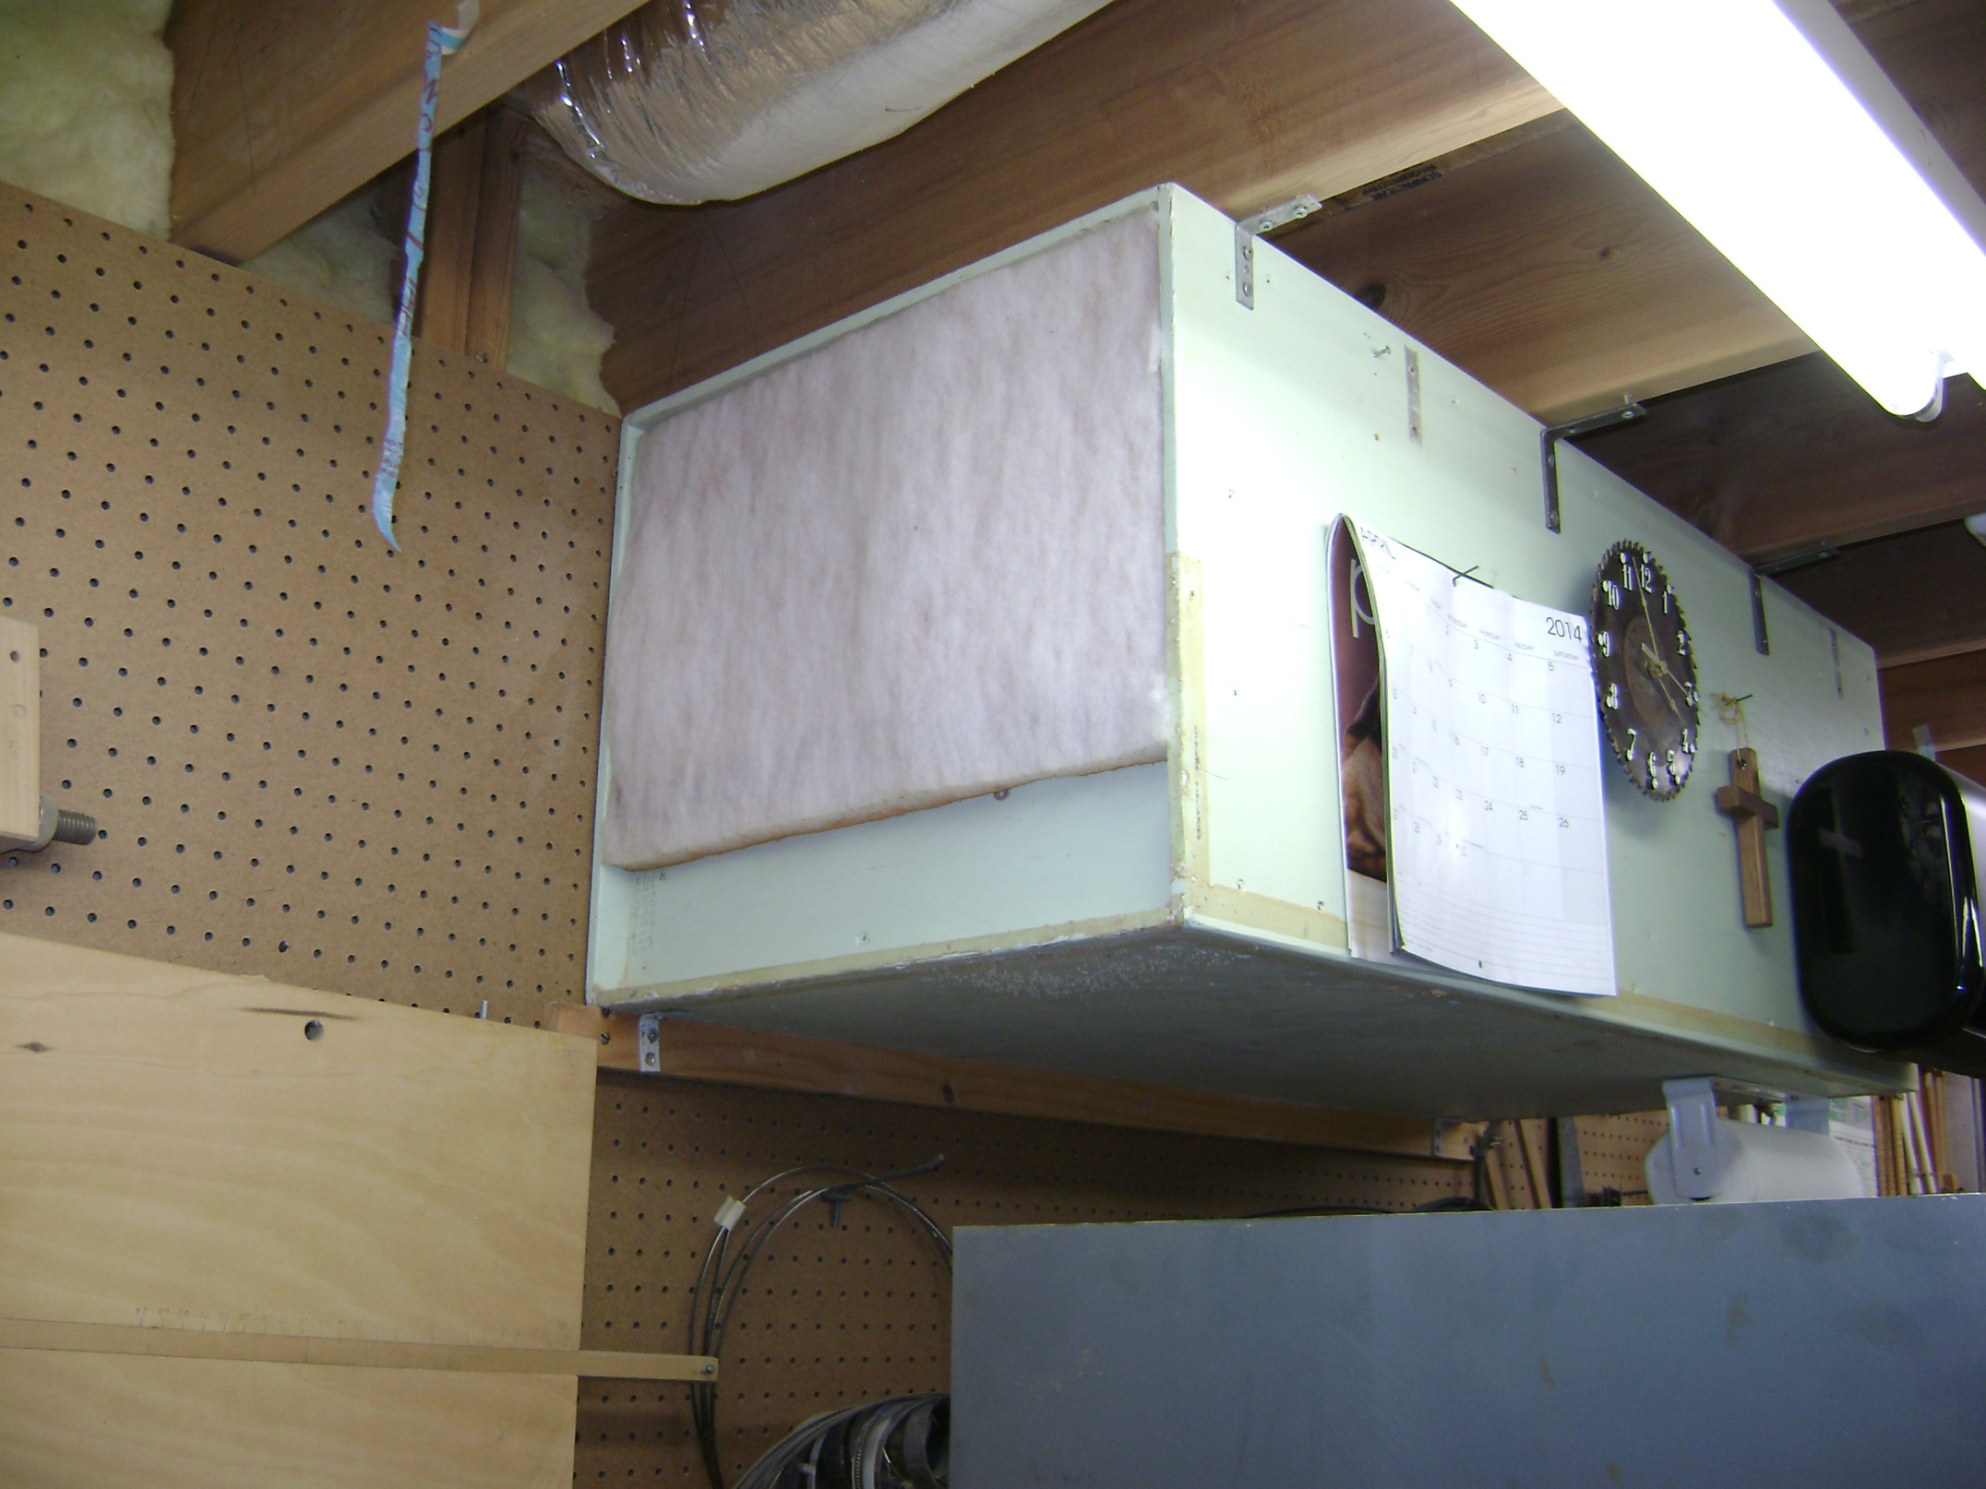

Slide 16
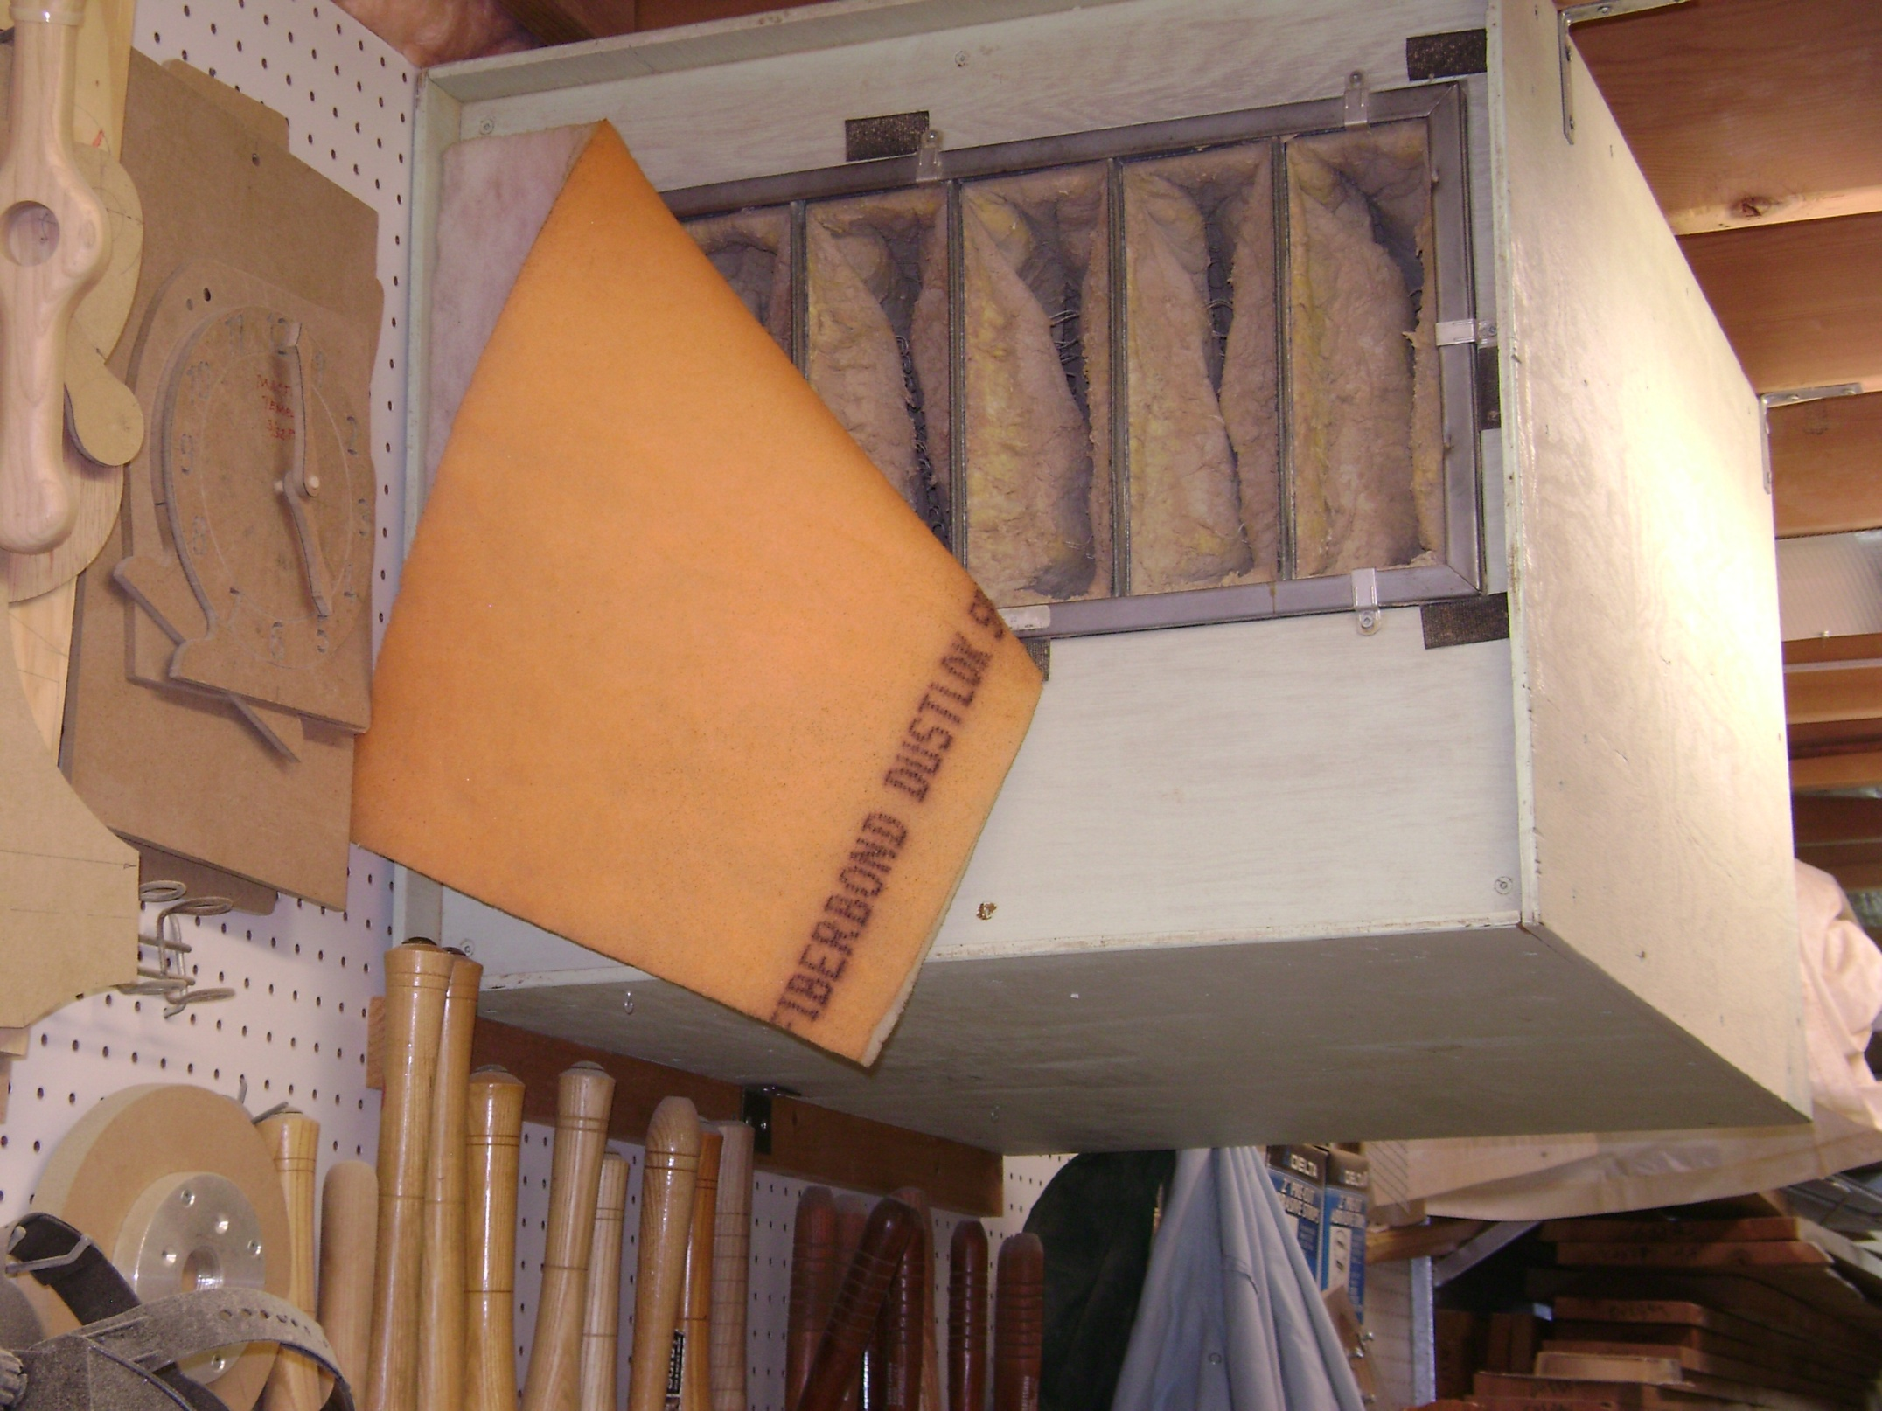

Slide 17
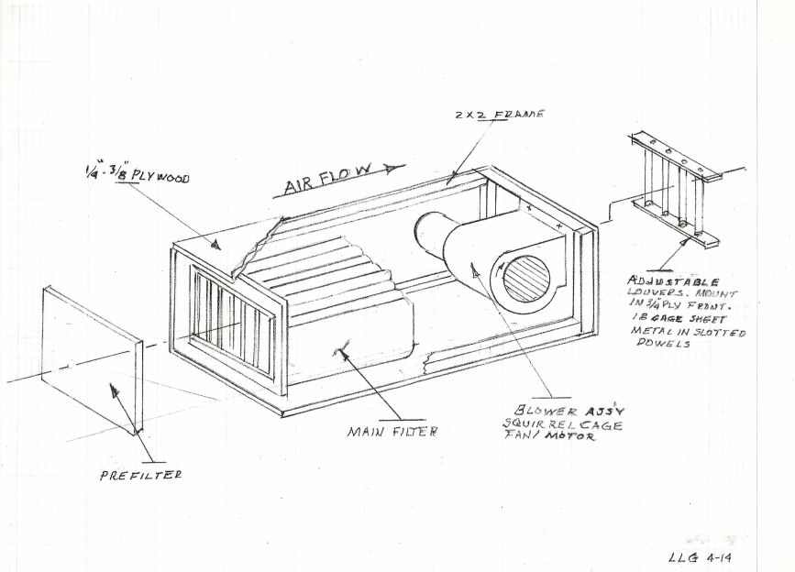

Slide 18
4. Select an appropriate size prefilter media, either 1” or 2 “thick. This media can be purchased in roll form or precut to your needs. Approx. cost of $62.34 for a 1” thick x 12” wide x 90 foot roll. This material has a Merv 7 rating. A sticky back media is preferred.
5. Design the case for the filter size and the blower unit you choose using 2” x 2” framing.

Slide 20
Mount the motor on a ¾ “piece of plywood for strength with an opening in line and equal to the blower housing exit. The on/off switch and power cord could also be mounted on this end. Attach the plywood to the frame from the outside to allow easy removal for service and hanging the unit. Making a louver in the exhaust opening will enable you to direct the air flow from the unit. Mount the main filter with a couple of small Z clamps in the recess provided in the frame.

Slide 21
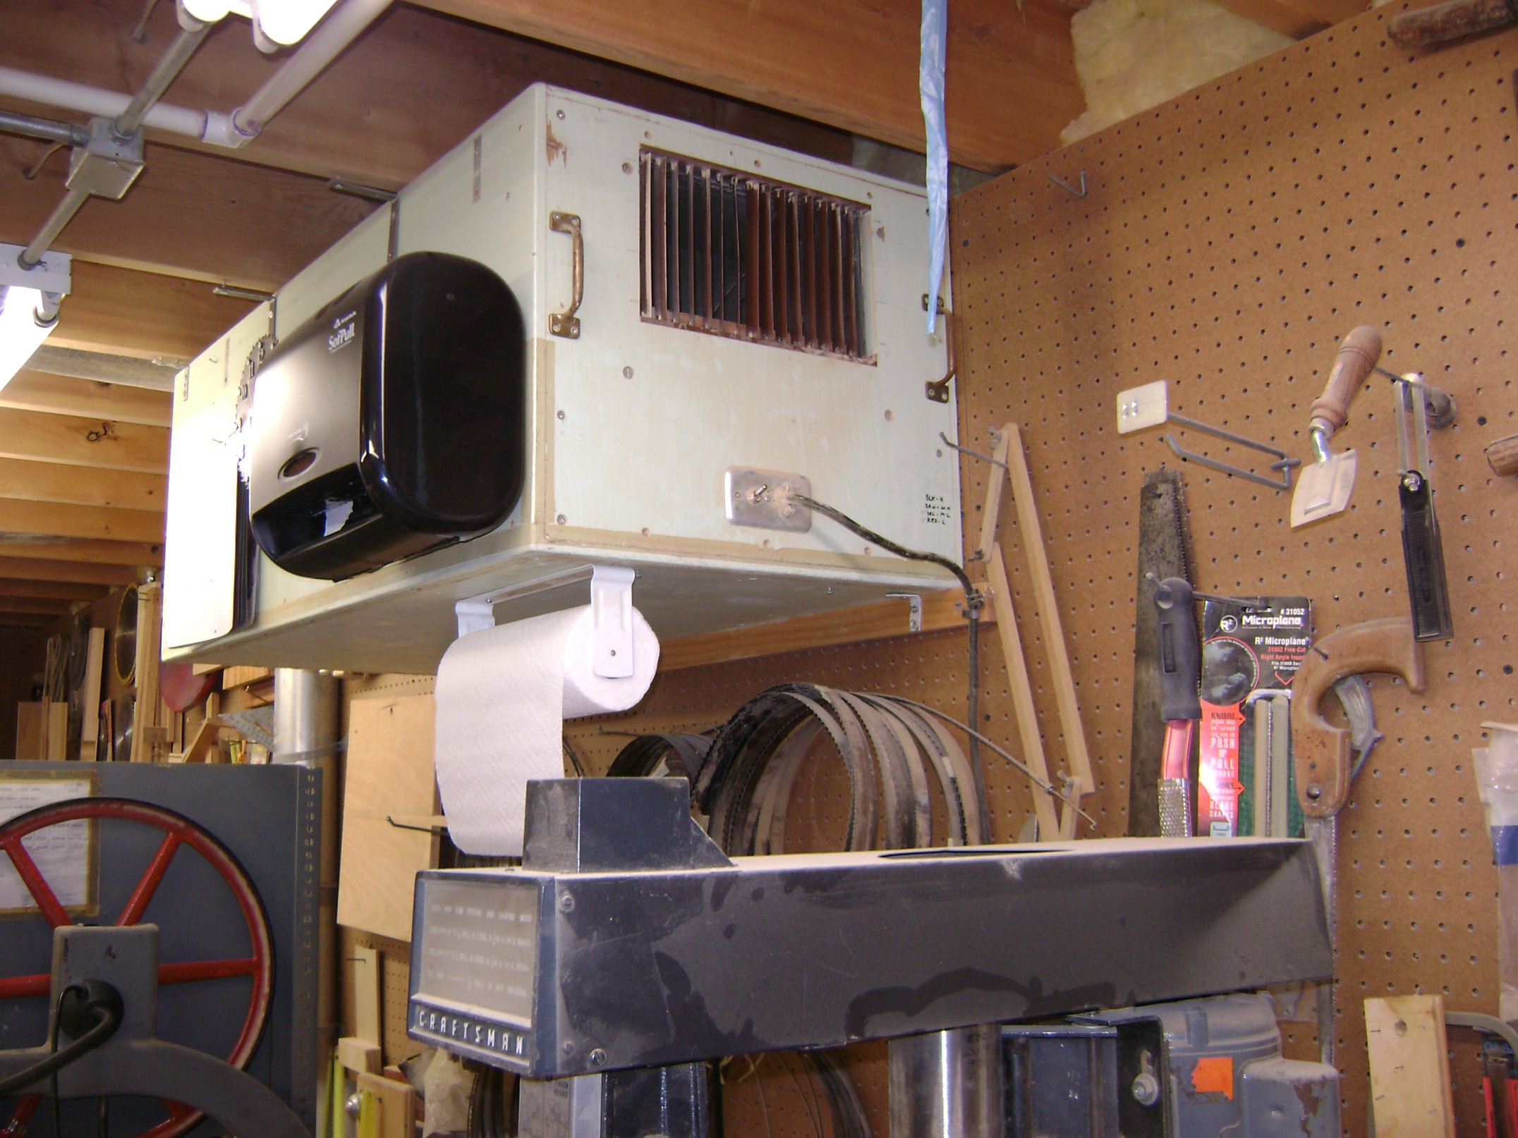

Slide 22
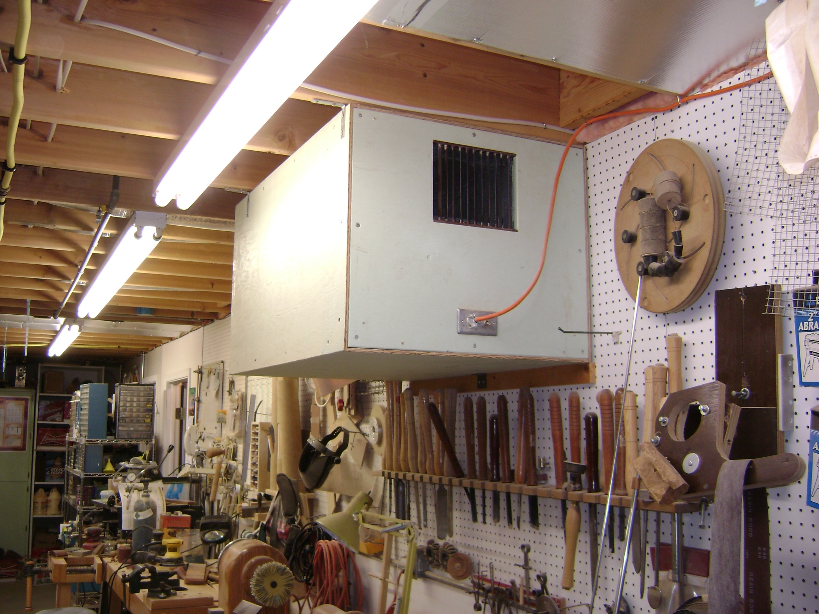

Slide 23
Place a couple of Velcro strips in the recess to hold the prefilter covering the face of the main bag filter.
Cover the 4 case sides with a 3/8” plywood skin.

Slide 25
Mount eye bolts on top of case to allow hanging the unit with chain, or angle brackets.
An air flow meter can be used to measure the approx. output of the unit.

Slide 27
Sources for Components
High efficiency bag filters and prefilter materials can be purchased through Air Filter Technology @ 614-921-9801. Contact Shelly for quotes. They sell Glasfloss filters.
Airguard Venti-Pac filters can be purchased from TFS Branch office in Cols. @614-885-9100 call for quotes.

Slide 28
Sources for Components – Cont.
Both suppliers #1 & 2 sell prefilter media in several thicknesses in roll or pre-cut sizes.
Dwyer Instruments #460 is an air meter that will measure velocity of air flow and static pressure. $37.00
Lou Gatch
Presented 5-10-2014 to WOCO

Slide 29
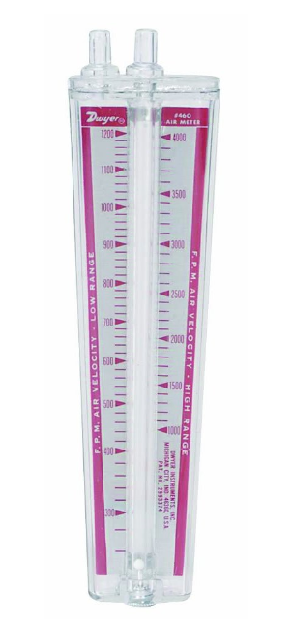
Sources for Components – Cont.
Dwyer Instruments #460 air meter
Lou Gatch
Presented 5-10-2014 to WOCO

